Slide 1

Lesson: 6.05 – Dictionary Project
Microsoft Philanthropies TEALS Program – Introduction to Computer Science – Semester 2
Notes:
Link updated 12/30/19
Link to Lesson 6.04: https://tealsk12.gitbook.io/intro-cs-2/unit6/lesson-4

Slide 2
Dictionary Project
After this lesson, you will be able to...
Use dictionaries to create a program

Slide 3
Today’s Plan
Do Now
Review
Project Overview
Project planning
Notes:
Links Updated 12/30/19
5 Minutes- Do Now: https://tealsk12.gitbook.io/intro-cs-2/unit6/lesson-4/do_now
10 Minutes- Review
10 Minutes- Project Overview
Guess Who: https://tealsk12.gitbook.io/intro-cs-2/unit6/lesson-4/project
Buy an Umbrella: https://tealsk12.gitbook.io/intro-cs-2/unit6/lesson-4/projectb
30 Minutes - Project Planning

Slide 4
6.05 – Do Now
Write down your ranking of these concepts from easiest to hardest
Creating dictionaries
Adding items to dictionaries
Updating items in dictionaries
Looping through items in a dictionary
Having lists as values in a dictionary
Checking if an item is in a dictionary as a key
Notes:
Directions:
Take time to review the concepts students found most challenging during this unit.

Slide 5
Four Steps to Solving Any (CS) Problem
Understand the problem
Make a plan
Implement your plan
Reflect on your solution
Notes:
Directions: Review each of these steps with the students, reminding them what each step accomplished and the strategies they might use.

Slide 6
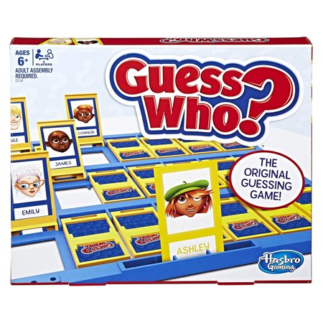
Guess Who?

Slide 7
Guess Who Project – Overview
The game should store information on at least 5 different characters.
Each character should have a name, gender, age, height, and hair color.
When the game begins, a character should be randomly selected by the computer.
The player can ask for 2 pieces of information about the random character, and then has to make a guess as to who was picked.
Notes:
Link updated on 12/20/19
Guess Who Project: https://tealsk12.gitbook.io/intro-cs-2/unit6/lesson-4/project

Slide 8
Guess Who Project – Behavior/ Commands
list: list out all the characters' names
gender/age/height/hair: asks for a piece of information
guess name: guess a character
help: displays all commands
quit: exits the game

Slide 9
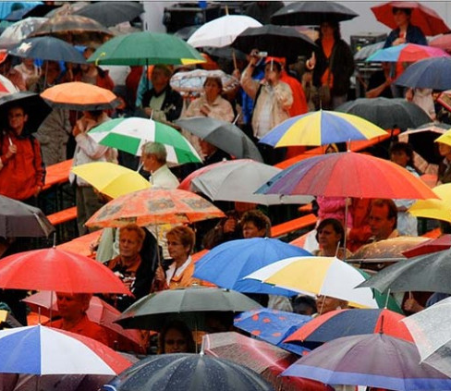
Buy an Umbrella
Notes:
This is an alternative project to the Guess Who Game
In this project, students will build a text version of a shopping site where you can browse and filter a catalog of umbrellas before buying one. Let students know that you will provide them with starter code and a text file. There are extensive details on this project in the lab directions, including milestones. Be sure students have a copy of the lab requirements.
Link to project: https://tealsk12.gitbook.io/intro-cs-2/unit6/lesson-4/projectb#overview
Link to starter code:
Link to text file:

Slide 10
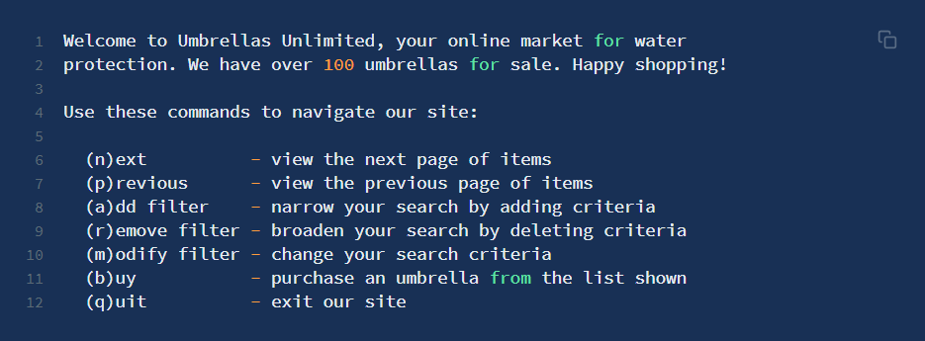
Overview
The program starts by loading an inventory of umbrella models from a text file. Afterwards, it greets the user with a welcome message.

Slide 11
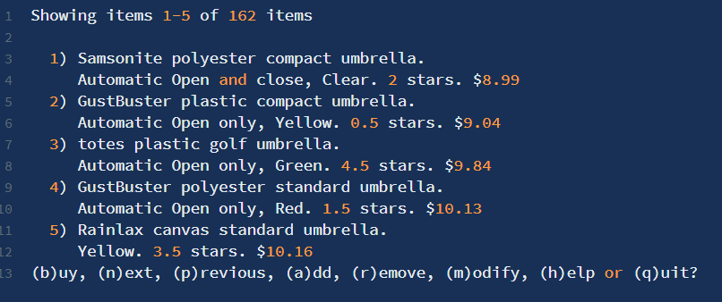
Overview Continued
Then it allows the user to browse and filter the catalog of available umbrellas.
Users should be able to add, remove, and modify filters.
Finally the user should be given the option to purchase one of the currently displayed umbrellas.

Slide 12
Milestones
Program can print the welcome message and action prompt, but can't actually take any actions.
Program can load the inventory of umbrella models from the text file, and print out a nice representation of the top 10.
Program supports the actions (n)ext and (p)revious.
Program supports the (b)uy action, allowing users to select one of the shown models and "purchase" it.
Program applies the current filters (if any), and always displays just the subset of umbrella models that match those filters.
Program supports the (a)dd, (r)emove, and (m)odify filter action.
Notes:
You may need to explain to students what hard coded means.
There is more detailed information about these milestones in the program description.

Slide 13
Make a Plan
Plan your Code – Using pseudo code, plan your variables, functions, dictionaries, lists, and structure
Plan your Time – Outline your daily goals and milestones to keep you on top of your project.
Notes:
Support students in creating a plan for their code and think about their time management

